Slide 1
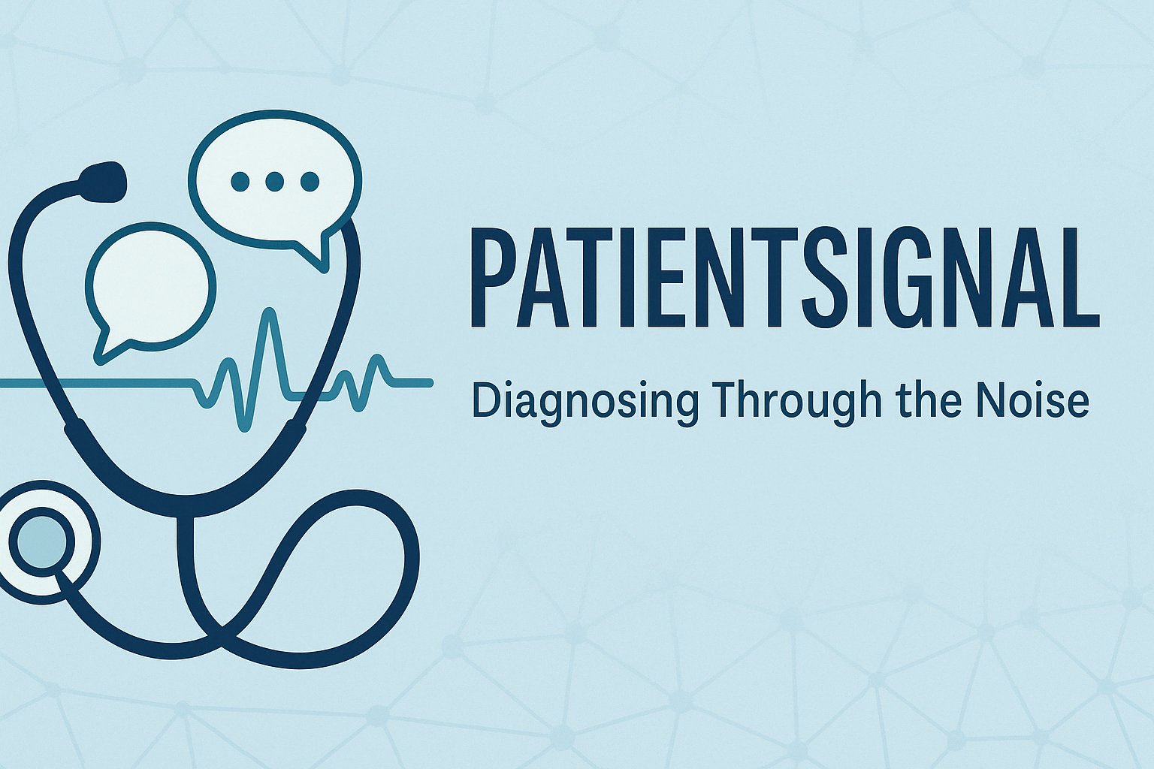
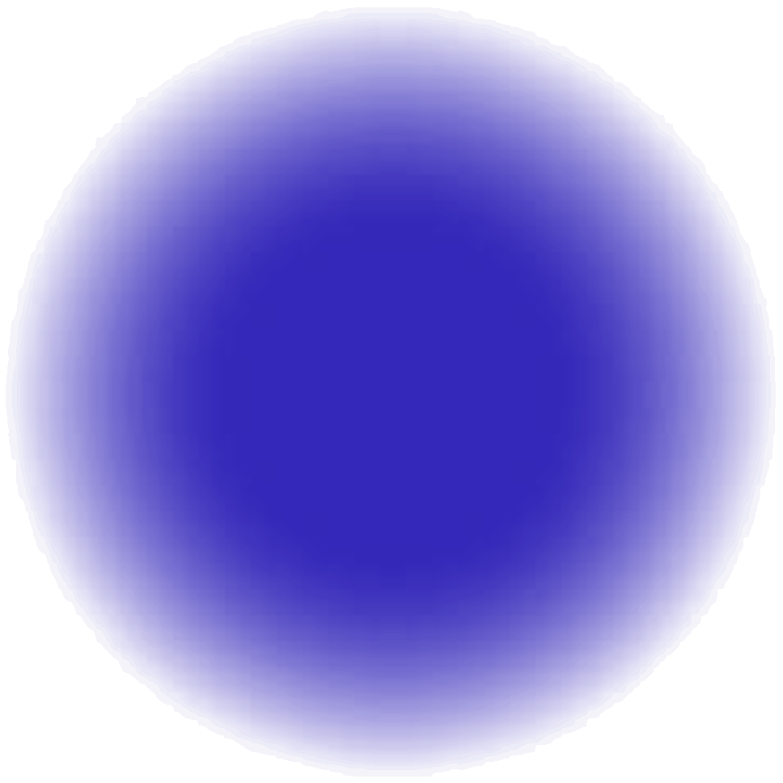
Group Members:
Eden Mama 318799103 and
Liel Sheri 206509861

Slide 2

Project Description
PatientSignal helps us turn patients’ own descriptions of their symptoms into reliable diagnoses even when they ramble or drop in unrelated chatter. We began with 1,200 carefully cleaned symptom texts and then used a Ollama prompt to weave in two levels of “real‑world” noise (80-220 words of small talk or 150-390 words of extended anecdotes). Finally, we compare classic baselines (MultinomialNB Naïve Bayes) against a fine‑tuned BERT model, evaluating them by accuracy.
Prediction | Text | Version
Psoriasis | My skin is extremely sensitive and quickly irritated by changes in temperature or humidity. My nails have developed dents on them. I am worried about this sudden change. | Clean
Psoriasis | "Oh dear, my skin... it just gets so red and tender now. Can't even go outside without gettin' all irritated. Temperature changes, humidity... I swear, I'm like a leaf in the wind. Reminds me of that time at the beach when I was a youngin', got sunburned to a crisp on my poor face... (chuckles) Oh, where's my mind? Ah yes, the skin. And now these dents on my nails! Like little holes or somethin'. Never had that before. Started last month, maybe? Or was it two months ago? Time just gets away from you, doesn't it? Anyway... I'm worried about this. It's like my body's fallin' apart on me." | Medium Noise (80-220(
Psoriasis | Um, doc... (pauses) I've been having this... this trouble with my skin, you see. It's just so sensitive all of a sudden. Even when I'm out in the garden on a lovely day, and it's warm... (hesitates) oh dear, what was I saying? Ah yes, warm weather. My skin gets all red and irritated, like a rash or something. And then it starts to itch, terrible itching. Can't even wear my nice new scarf without breaking out in hives... (pauses again) And the nails! Goodness gracious, have you ever seen anything like this? Dents on my fingernails, all uneven and whatnot. It's as if... (stammers) I think it might be that time of year again, you know, when the pollen counts are high... (starts to digress) Did I tell you about the time I got a new cat, Whiskers? She was such a sweet thing, always purring on my lap... (trails off). Where was I? Ah yes, the nails. It's like they're trying to tell me something, but what, I don't know. And it started so suddenly! One day fine, next day... (pauses) Oh dear, I remember now: it happened after that big storm we had last month. Maybe it was something in the air? Or maybe it's just my imagination playing tricks on me... (chuckles nervously) I'm worried about this sudden change, doc... (hesitates again) If I can just get to the bottom of what's causing it all... (trails off into incoherent muttering) | Heavy Noise (150-390)

Slide 3
Previous works
Comparing BERT against traditional machine learning text classification, 2020 | DiagnoAI, 2022 | “Optimizing classifcation of diseases through language model analysis of symptoms”, 2024 | Source/Title
Compared BERT (fine-tuned) to classical TF-IDF + ML models (e.g. Logistic Regression, SVM, NB, etc.) across 4 datasets and 3 languages (English, Portuguese, Chinese). | Manually generated patient symptom based on symptom lists from Kaggle's dataset, Created 50 descriptions per disease (24 diseases, total of 1200 examples). Fine-tuned all layers of pretrained BERT (TensorFlow) using SparseCategoricalCrossentropy and Adam optimizer. | Fine‑tuned BERT with Medical Concept Normalization, optimized separately with AdamP and AdamW and a Bidirectional LSTM model tuned via Hyperopt. | Approach/Model
IMDB dataset, RealOrNot tweets, Portuguese news dataset and Chinese hotel reviews | Disease Symptom Prediction Dataset | Symptom2Disease | Data
Accuracy | Accuracy | Accuracy, Precision, Recall and F1-Score | Metrics
IMDB: 93.87% RealOrNot: 83.61% Portuguese news: 90.93% Chinese hotel reviews: 93.81% | Validation Accuracy: 98.33% | MCN-BERT + AdamP: 99.58% Accuracy, 99.18% Precision, 99.28% Recall and 99.13% F1-Score. MCN-BERT + AdamW: 98.33% Accuracy, 98.39% Precision, 98.23% Recall and 98.18% F1-Score. BiLSTM + Hyperopt: 97.08% Accuracy, 97.37% Precision, 97.08% Recall and 97.05% F1-Score. | Results

Slide 4
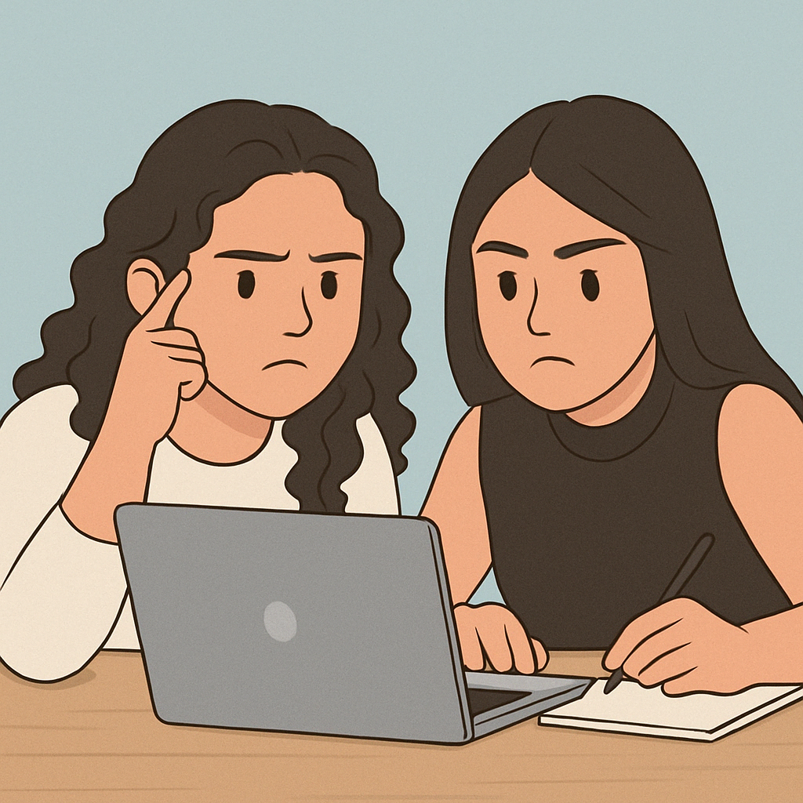
Our plan
Preprocessing:
Kaggle’s Symptom-Based Disease Labeling dataset
Noise Generation: Prompt-based augmentation using Ollama (Llama3.1:8b) to simulate medium (80-220 words) and heavy (150-390 words) noise levels
Final Dataset:
3,600 examples: clean, medium-noise, and heavy-noise, all with the same labels (24).
Models:
Naïve Bayes
Fine-tuned BERT
Evaluation Metrics:
Accuracy per model and per noise level.

Slide 5
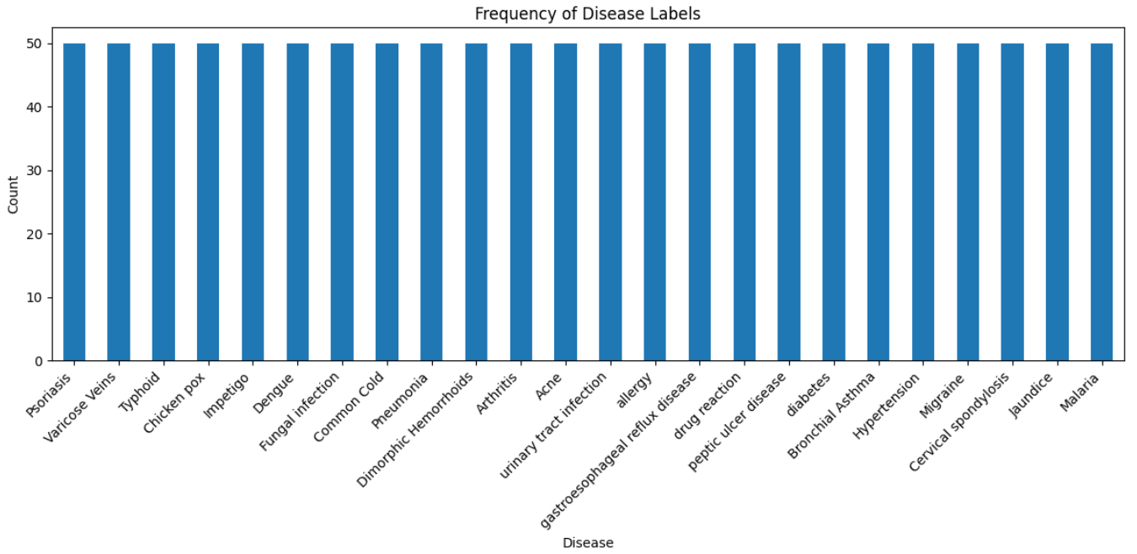
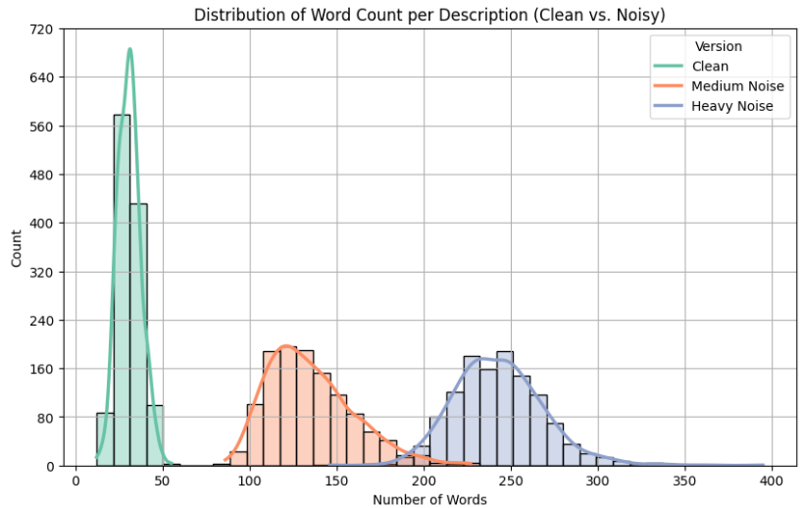
Data exploration and baseline
Disease Label Distribution:
All 24 disease labels are evenly distributed, ensuring a balanced classification task and no bias in training. This supports fair evaluation across models.
Word Count Distribution (Clean vs. Noisy):
The histogram shows a clear increase in average word count as noise increases. clean descriptions are short and focused, while noisy versions (medium & heavy) contain added off-topic content.

Slide 6
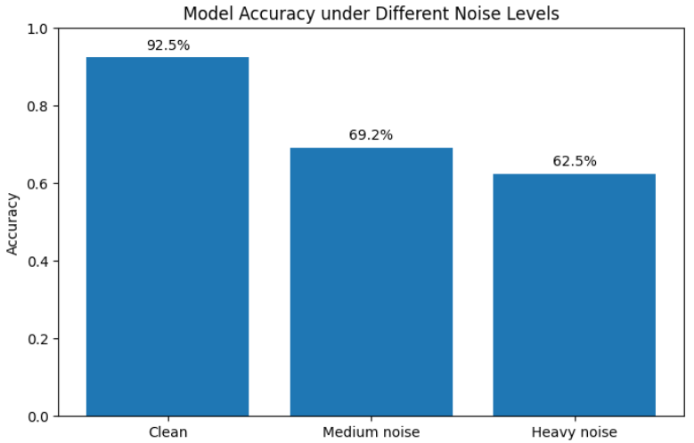
Multinomial Naïve Bayes Model:
Clean data accuracy: 92.5%
Medium noise accuracy: 69.2%
Heavy noise accuracy: 62.5%

Slide 7

Insights & Recommendations
Insights:
Noise reduces accuracy: 92.5% (clean) → 69.2% (medium noise) → 62.5% (heavy noise).
Ollama is an effective model for generating realistic noise.
Recommendations:
If BERT fails to show improvement, enhance preprocessing.
If results remain weak, we will try to use DeBERTa.

Slide 8

Thank you!

